Slide 1



Machine Learning
Internal
Poshak, May 20, 2019

Slide 2
Agenda
Regression
Recap ☺ of last session
Linear regression using Regularization
Classification
Random Forest
Decision Trees
GDT
Logistic Regression
Math behind logistic regression
Multi Class Classification (One-vs-All)
Demo + Hands On
Scikit-Learn
sklearn Demo + Hands On
Queries ?

Slide 3
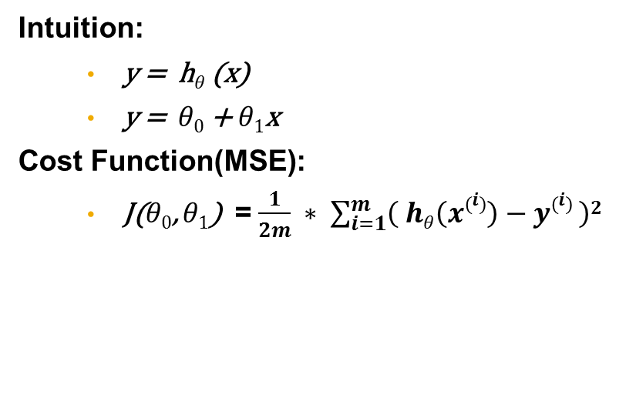
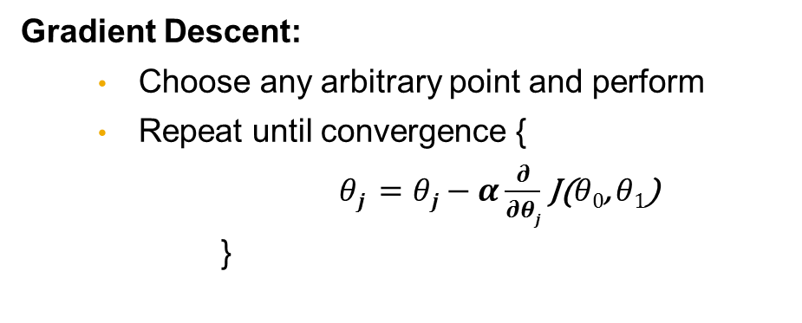
Linear Regression Recap
Intuition:
y = h$θ$(x)
y = $θ0$ + $θ1$x
Cost Function(MSE):
J($θ0$, $θ1$) = $\frac{1}{2m} ∗ \sum_{i=1}^{m}{\left( hθ\left(x\left(i\right)\right)−y\left(i\right) \right)2}$
Gradient Descent:
Choose any arbitrary point and perform
Repeat until convergence {
$θj =θj−α\frac{∂}{∂θj}$ J($θ0$, $θ1$)
}
Notes:
Steps:
1.) when a plot is represented between the theta and error, repeat the loop until the convergence
2.) derive the theta0, theta1

Slide 4
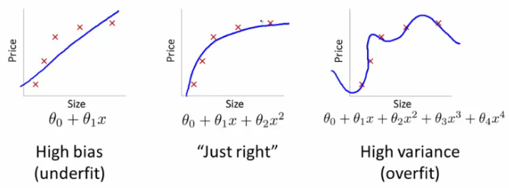
Bias Vs. Variance
Notes:
Steps:
1.) Underfitting -> less number of records to training or wrong training model
2.) Overfitting -> more number of features the model depends on.
Minimizing the overfitting
1.) remove some features -> this might remove some of the information model might require
2.) regularization

Slide 5
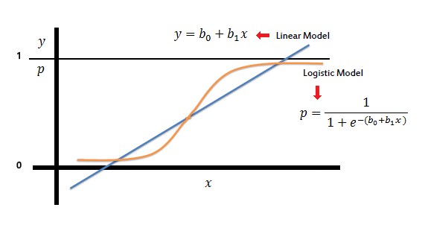

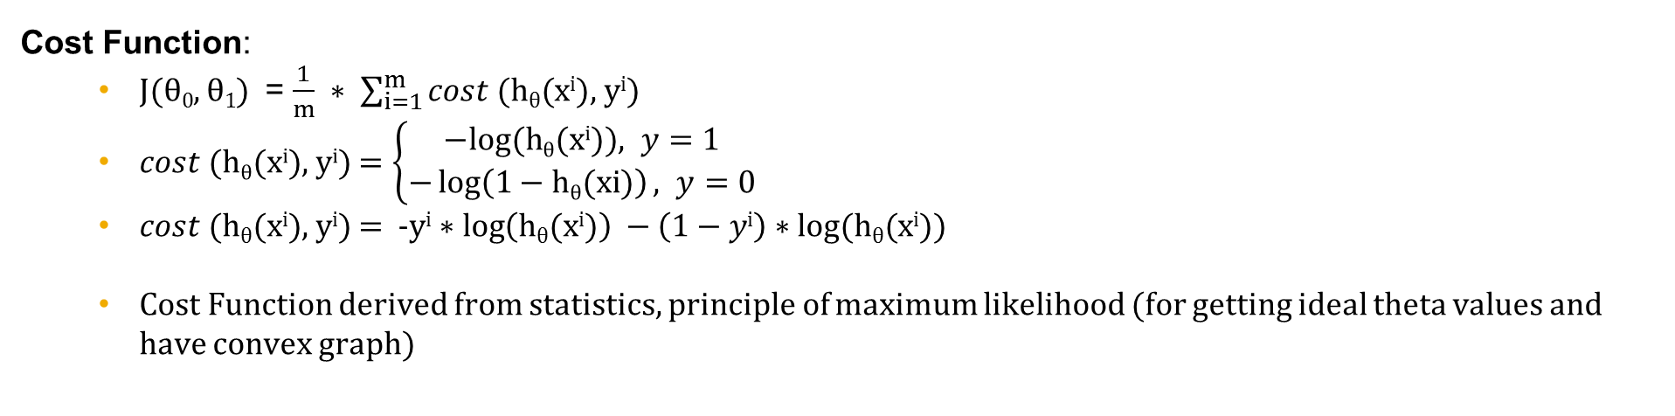
Classification - Logistic Regression
Intuition:
y = h$θ$(x) = g$θ$(z)
g$θ$(z) = $1/{(1+e−z)}$
z = $θTX$
Decision Boundary:
p(y=1/x; $θ$) ; h$θ$(x) $≥$ 0.5 ; z $≥$ 0
p(y=0/x; $θ$) ; h$θ$(x) $≤$ 0.5 ; z $≤$ 0
Cost Function:
J($θ0$, $θ1$) = $\frac{1}{m} ∗ \sum_{i=1}^{m}{cost (\text{h}θ\text{(}\text{xi}\text{), }\text{yi})}$
$cost (\text{h}θ\text{(}\text{xi}\text{), }\text{yi})$ $=\left\{\begin{aligned}−&log⁡(\text{h}θ\text{(}\text{xi}\text{)}), y=1 \\ −\log\left(1−\text{h}θ\text{(}\text{xi}\text{)}\right), y=0\end{aligned}\right.$
$cost (\text{h}θ\text{(}\text{xi}\text{), }\text{yi})$ = -y$\text{i}∗\log\left(\text{h}θ\text{(}\text{xi}\text{)}\right) −\left(1−y\text{i}\right)∗log⁡(\text{h}θ\text{(}\text{xi}\text{)})$
Cost Function derived from statistics, principle of maximum likelihood (for getting ideal theta values and have convex graph)

Slide 6
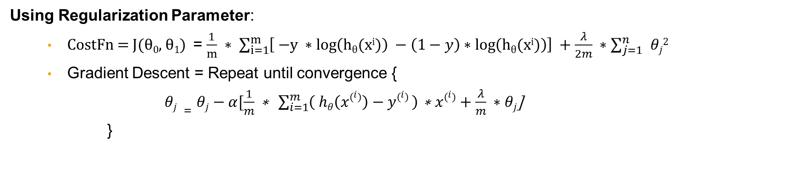
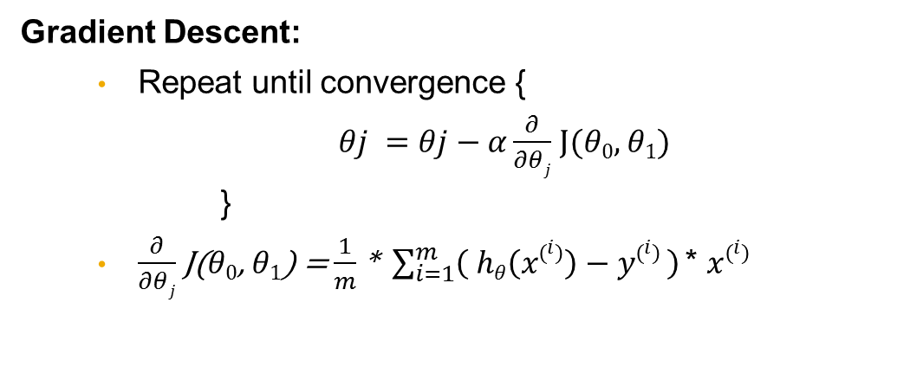
Logistic Regression (Contd.)
Gradient Descent:
Repeat until convergence {
$θj =θj−α\frac{∂}{∂θj}$ J($θ0$, $θ1$)
}
$\frac{∂}{∂θj}$ J($θ0$, $θ1$) = $\frac{1}{m}$ * $\sum_{i=1}^{m}{\left( hθ\left(x\left(i\right)\right)−y\left(i\right) \right) }$* $x\left(i\right)$
Using Regularization Parameter:
CostFn = J($θ0$, $θ1$) = $\frac{1}{m} ∗ \sum_{i=1}^{m}{\left[ \text{−}\text{y} ∗\log\left(\text{h}θ\text{(}\text{xi}\text{)}\right) −\left(1−y\right)∗\log\left(\text{h}θ\text{(}\text{xi}\text{)}\right)\right] +\frac{λ}{2m} ∗\sum_{j=1}^{n}{ }θj2}$
Gradient Descent = Repeat until convergence {
$θj =θj−α[\frac{1}{m}\text{ ∗ }\sum_{i=1}^{m}{\left( hθ\left(x\left(i\right)\right)−y\left(i\right) \right) }\text{∗ }x\left(i\right)+\frac{λ}{m} ∗θj$]
}

Slide 7
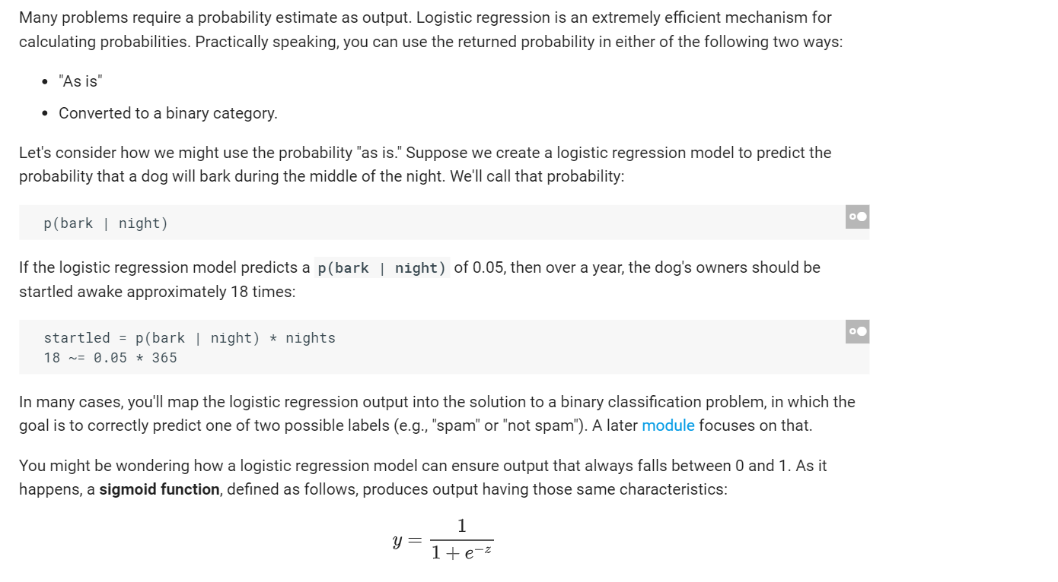
Logistic Regression: Calculating a Probability

Slide 8
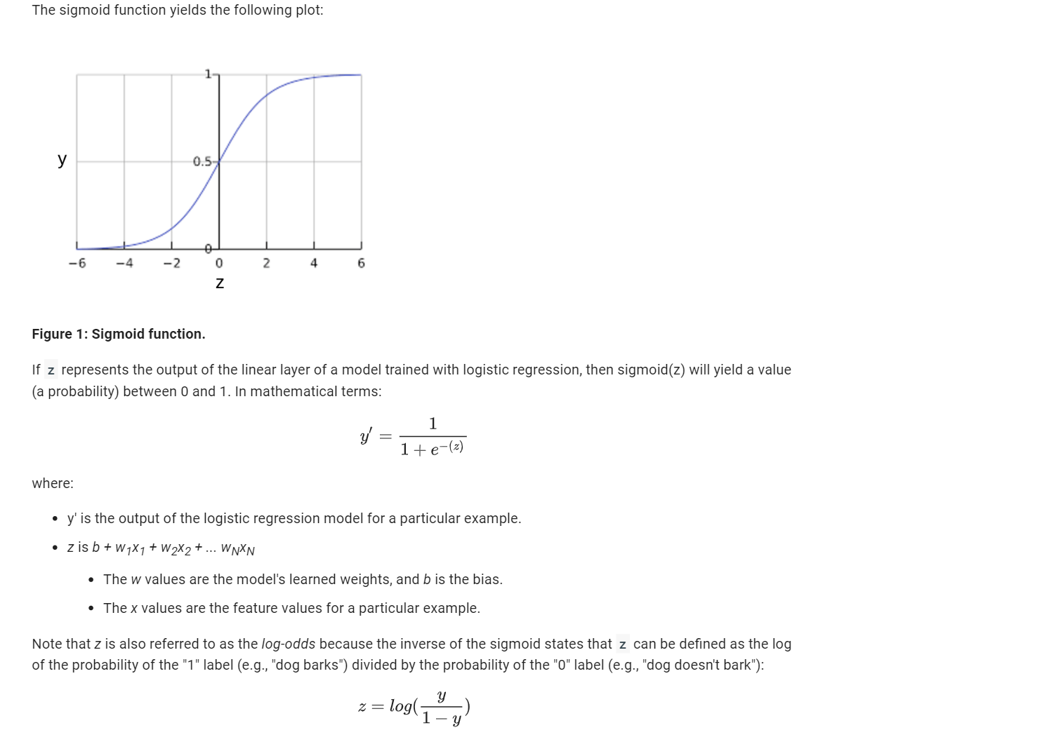

Slide 9
Question

Slide 10
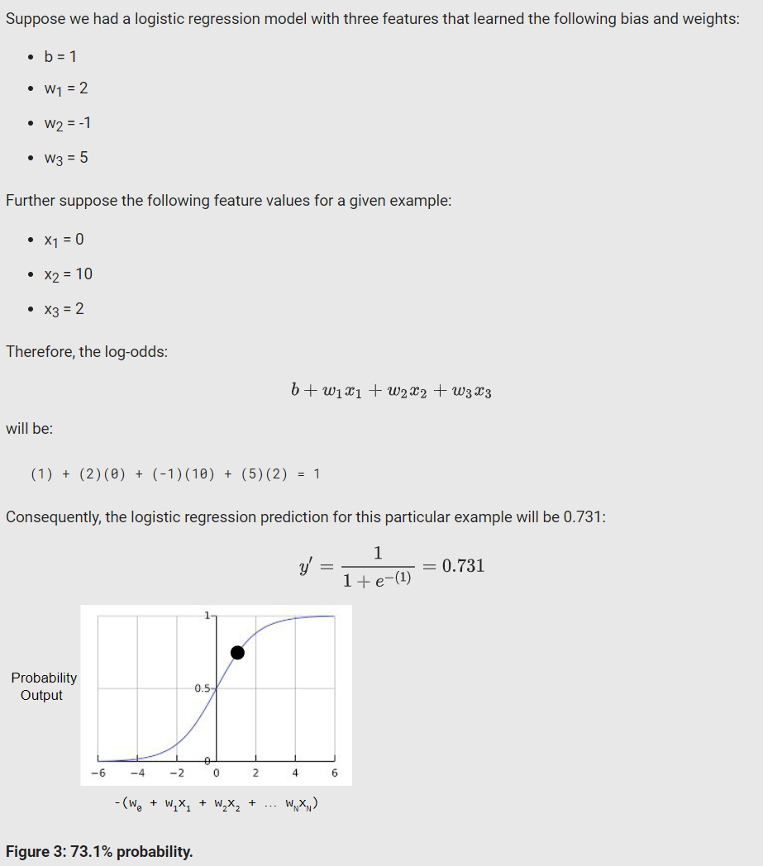
Question:-

Slide 11
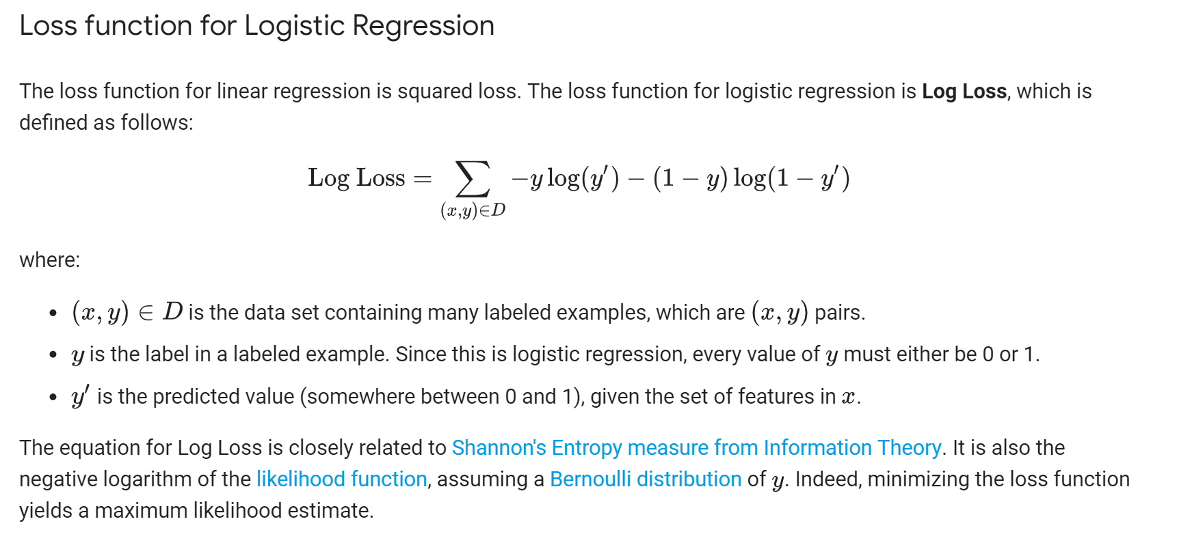

Slide 12
Classification: Thresholding
Logistic regression returns a probability.
You can use the returned probability "as is" (for example, the probability that the user will click on this ad is 0.00023) or convert the returned probability to a binary value (for example, this email is spam).
A logistic regression model that returns 0.9995 for a particular email message is predicting that it is very likely to be spam.
Conversely, another email message with a prediction score of 0.0003 on that same logistic regression model is very likely not spam.
However, what about an email message with a prediction score of 0.6? In order to map a logistic regression value to a binary category, you must define a classification threshold (also called the decision threshold). A value above that threshold indicates "spam"; a value below indicates "not spam." It is tempting to assume that the classification threshold should always be 0.5, but thresholds are problem-dependent, and are therefore values that you must tune.

Slide 13
Classification: True vs. False and Positive vs. Negative
An Aesop's Fable: The Boy Who Cried Wolf (compressed)
A shepherd boy gets bored tending the town's flock. To have some fun, he cries out, "Wolf!" even though no wolf is in sight. The villagers run to protect the flock, but then get really mad when they realize the boy was playing a joke on them.
[Iterate previous paragraph N times.]
One night, the shepherd boy sees a real wolf approaching the flock and calls out, "Wolf!" The villagers refuse to be fooled again and stay in their houses. The hungry wolf turns the flock into lamb chops. The town goes hungry. Panic ensues.
Let's make the following definitions:
"Wolf" is a positive class.
"No wolf" is a negative class.
We can summarize our "wolf-prediction" model using a 2x2 confusion matrix that depicts all four possible outcomes:

Slide 14
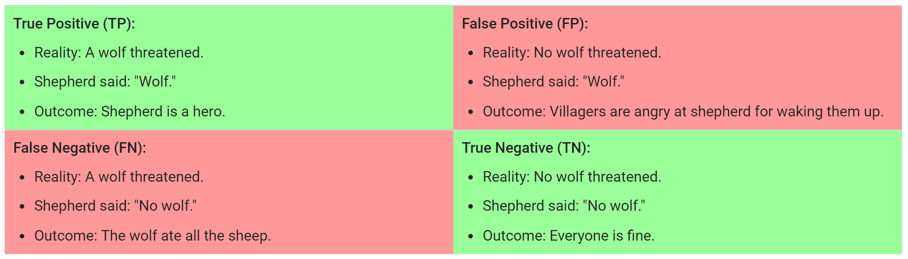
Notes:
A true positive is an outcome where the model correctly predicts the positive class.
A true negative is an outcome where the model correctly predicts the negative class.
A false positive is an outcome where the model incorrectly predicts the positive class.
A false negative is an outcome where the model incorrectly predicts the negative class.

Slide 15
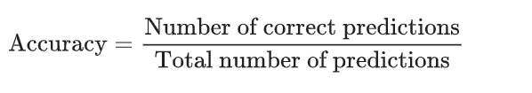

Classification: Accuracy
Accuracy is one metric for evaluating classification models. Informally, accuracy is the fraction of predictions our model got right. Formally, accuracy has the following definition:
For binary classification, accuracy can also be calculated in terms of positives and negatives as follows:
Where TP = True Positives, TN = True Negatives, FP = False Positives, and FN = False Negatives.

Slide 16
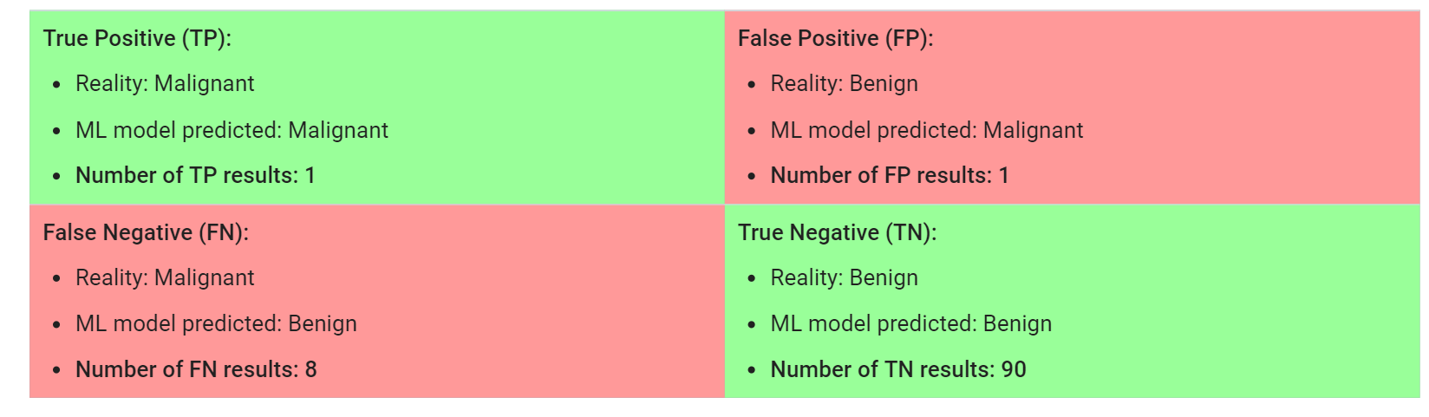
Let's try calculating accuracy for the following model that classified 100 tumors as malignant (the positive class) or benign (the negative class):
Notes:
Accuracy comes out to 0.91, or 91% (91 correct predictions out of 100 total examples). That means our tumor classifier is doing a great job of identifying malignancies, right?
Actually, let's do a closer analysis of positives and negatives to gain more insight into our model's performance.
Of the 100 tumor examples, 91 are benign (90 TNs and 1 FP) and 9 are malignant (1 TP and 8 FNs).
Of the 91 benign tumors, the model correctly identifies 90 as benign. That's good. However, of the 9 malignant tumors, the model only correctly identifies 1 as malignant—a terrible outcome, as 8 out of 9 malignancies go undiagnosed!
While 91% accuracy may seem good at first glance, another tumor-classifier model that always predicts benign would achieve the exact same accuracy (91/100 correct predictions) on our examples. In other words, our model is no better than one that has zero predictive ability to distinguish malignant tumors from benign tumors.
Accuracy alone doesn't tell the full story when you're working with a class-imbalanced data set, like this one, where there is a significant disparity between the number of positive and negative labels.

Slide 17


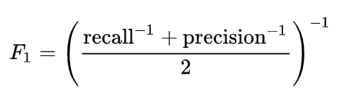
Precision attempts to answer the following question:
What proportion of positive identifications was actually correct?
Precision is defined as follows:
Recall attempts to answer the following question:
What proportion of actual positives was identified correctly?
Mathematically, recall is defined as follows:
Recall=TPTP+FN
The F₁ score is the harmonic average of the precision and recall, where an F₁score reaches its best value at 1 (perfect precision and recall) and worst at 0.
Notes:
Our model has a precision of 0.5—in other words, when it predicts a tumor is malignant, it is correct 50% of the time
Our model has a recall of 0.11—in other words, it correctly identifies 11% of all malignant tumors.
Homework Roc and AUC

Slide 18
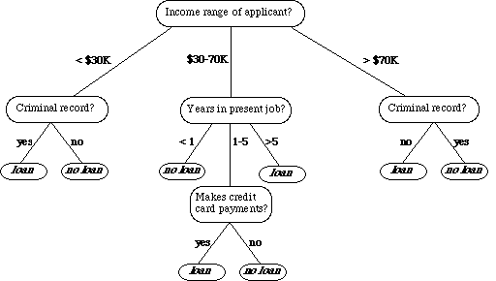
Decision Trees
It is a supervised learning approach
A decision tree is a tree where each node represents a feature(attribute), each link(branch) represents a decision(rule) and each leaf represents an outcome(categorical or continues value).
Notes:
if we are classifying bank loan application for a customer, the decision tree may look like this
Here we can see the logic how it is making the decision.
It’s simple and clear.
Why Decision trees:-
Decision tress often mimic the human level thinking so its so simple to understand the data and make some good interpretations.
Decision trees actually make you see the logic for the data to interpret(not like black box algorithms like SVM,NN,etc..)
https://medium.com/deep-math-machine-learning-ai/chapter-4-decision-trees-algorithms-b93975f7a1f1

Slide 19
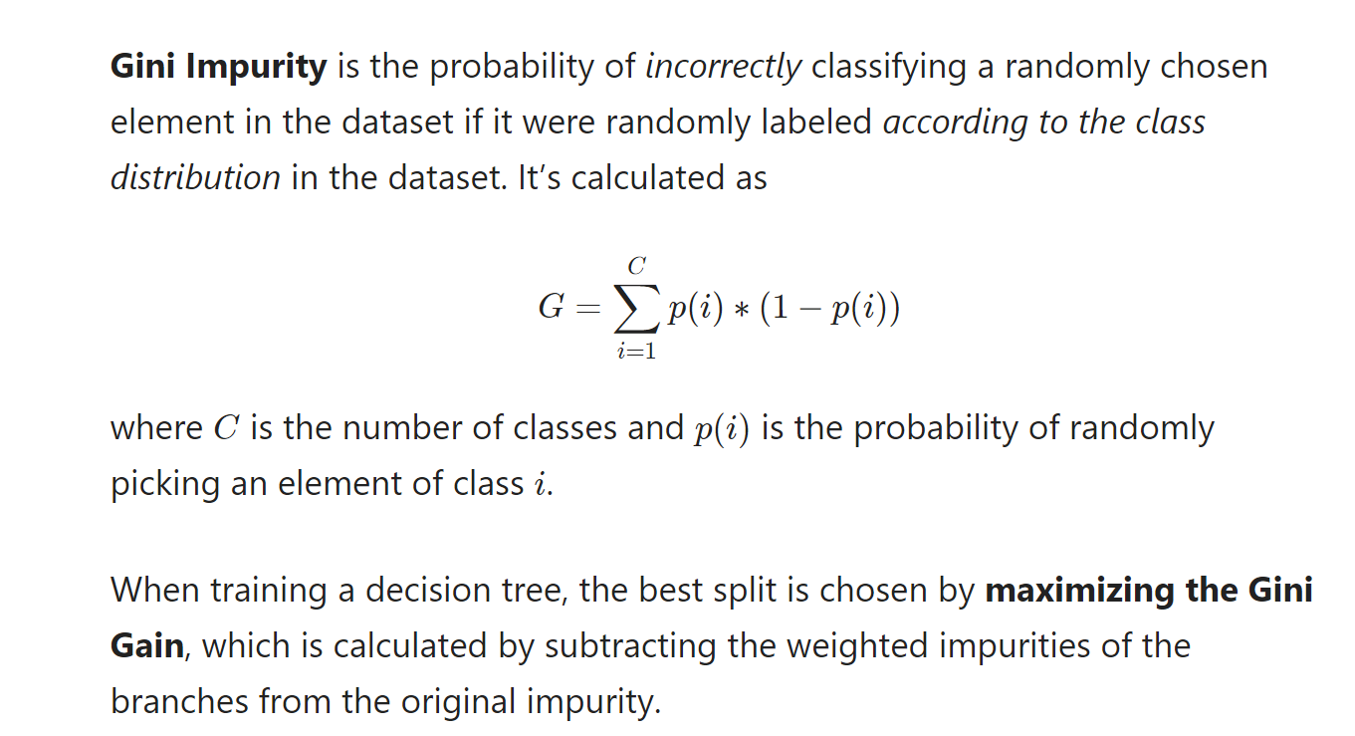
Notes:
https://victorzhou.com/blog/gini-impurity/

Slide 20
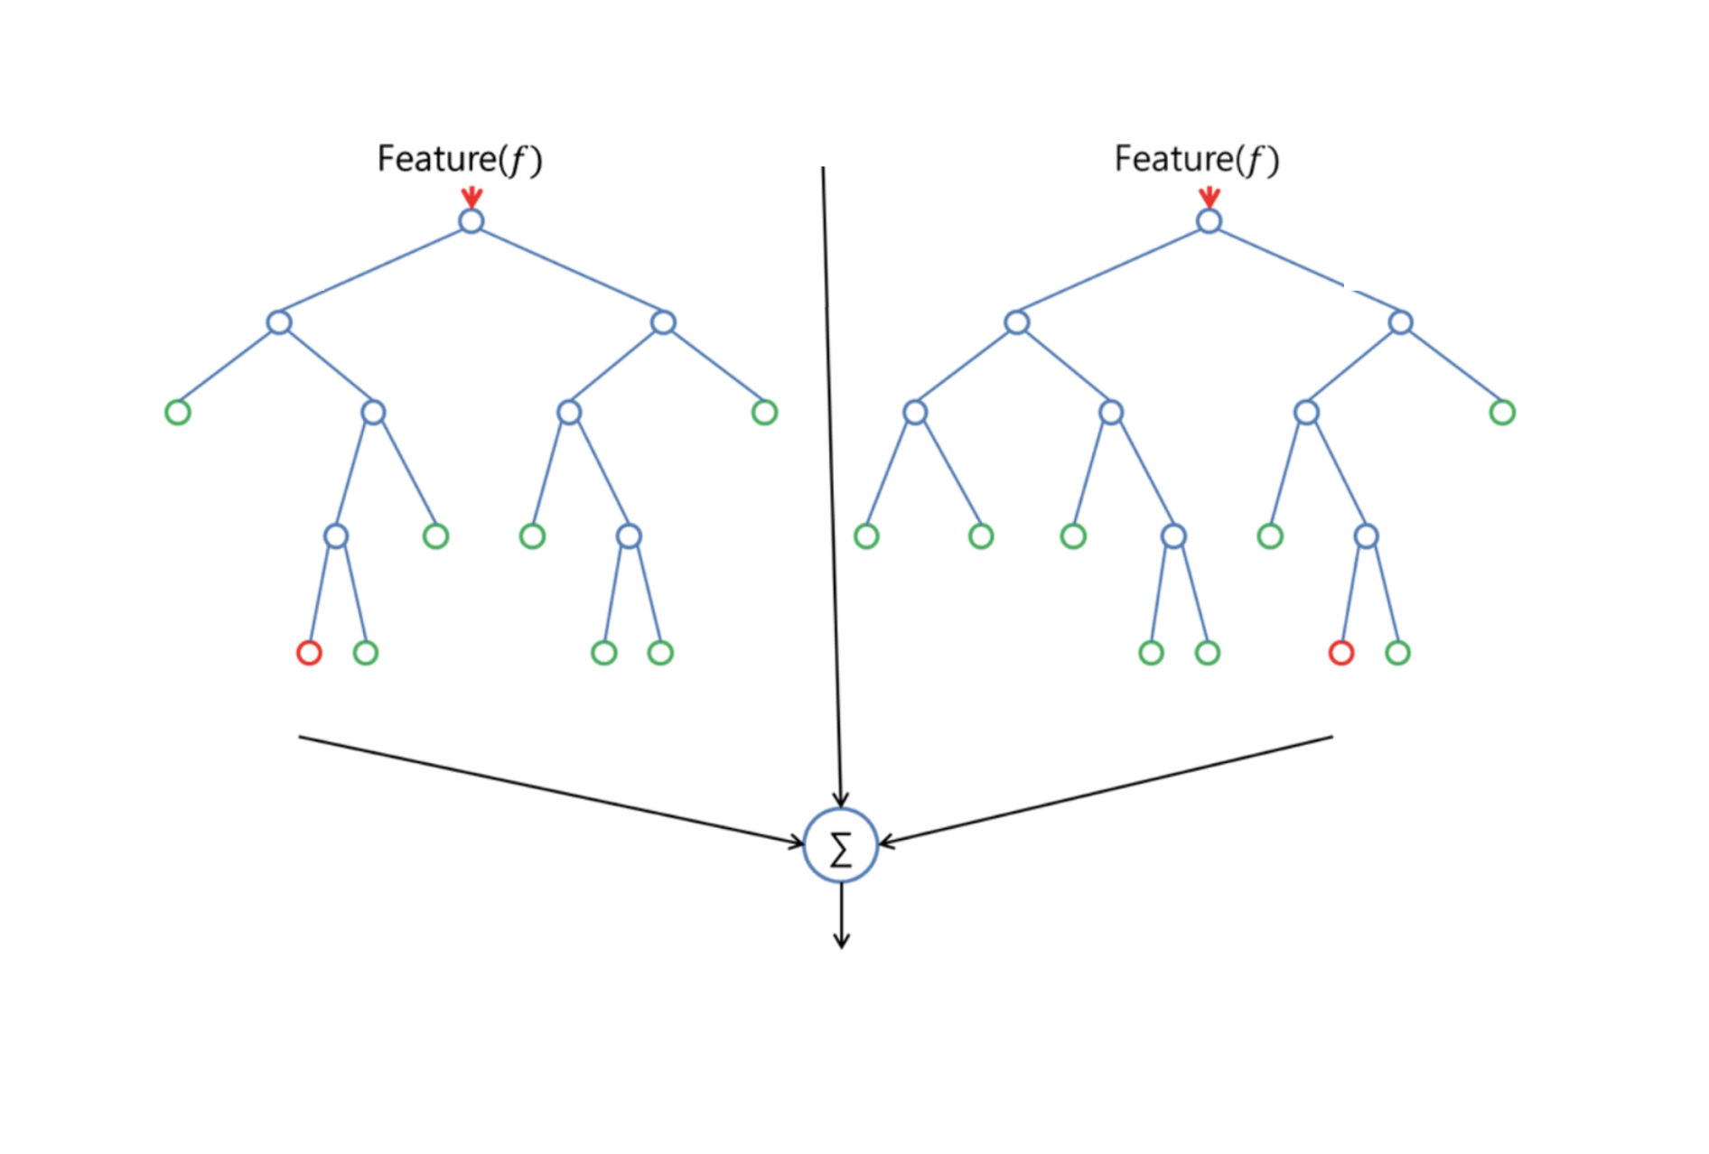
Random Forest
To say it in simple words: Random forest builds multiple decision trees and merges them together to get a more accurate and stable prediction.
Notes:
Real Life Analogy:
Imagine a guy named Andrew, that want’s to decide, to which places he should travel during a one-year vacation trip. He asks people who know him for advice. First, he goes to a friend, tha asks Andrew where he traveled to in the past and if he liked it or not. Based on the answers, he will give Andrew some advice.
This is a typical decision tree algorithm approach. Andrews friend created rules to guide his decision about what he should recommend, by using the answers of Andrew.
Afterwards, Andrew starts asking more and more of his friends to advise him and they again ask him different questions, where they can derive some recommendations from. Then he chooses the places that where recommend the most to him, which is the typical Random Forest algorithm approach.

Slide 21
Gradient Boosting Decision Tree (GBDT)
Gradient Boosting = Gradient descent + Boosting
Boosting = many weak predictive model into a strong one, in the form of ensemble of weak models.
Gradient Boosting Decision Tree = GB with decision tree models as weak models.

Slide 22
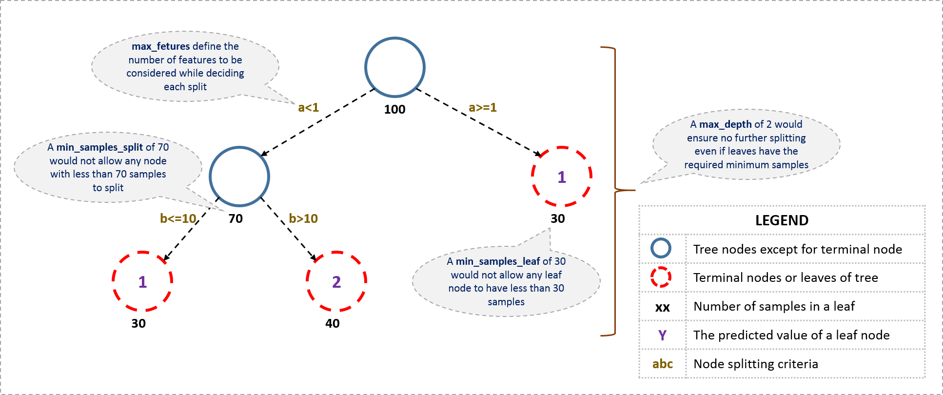

Slide 23
GBDTs and Random Forests
In a trained RandomForest model with 100 trees. If when predicting we drop the first or last tree, it doesn't affect the performance because they are trained independently.
In a trained GBDT model with 100 trees. If when predicting we drop the first or last tree, it affects the performance. ---- There's a sequence of trees each improve predictions of all previous trees, so if the first one is dropped, the performance will drop more than if the last one is dropped.
A RandomForest can be constructed in parallel.
A GBDT can't. It build trees in sequential manner. XGBoost builds only single trees in parallel.

Slide 24

Decision Tree Demo + HandsOn

Slide 25
Thank you
Contact information:
Sundeep Gullapudi
Developer/ Pentester
Ph: 8977061710

